Slide 1
Pesticide Suggestion and crop Disease classification using Machine Learning
GUIDE:
Mrs.R.Salini,M.tech.,
Assistant Prof, Dept of Cse
Panimalar Engineering College.
TEAM MEMBERS:
FARZANA A.J(211417104062)
YAMINI B(211417104308)

Slide 2
Introduction
Crop cultivation plays an essential role in the agricultural field. Presently, the loss of food is mainly due to infected crops, which reflexively reduces the production rate. To identify the plant diseases at an untimely phase is not yet explored.
The main challenge is to reduce the usage of pesticides in the agricultural field and to increase the quality and quantity of the production rate. Proposed system explore the leaf disease prediction at an untimely action. We propose an enhanced Machine Learning to predict the infected area of the leaves. A color based segmentation model is defined to segment the infected region and placing it to its relevant classes.
Experimental analyses were done on samples images in terms of time complexity and the area of infected region. Plant diseases can be detected by image processing technique. Disease detection involves steps like image acquisition, image pre-processing, image segmentation, feature extraction and classification.

Slide 3
Literature Survey
S.NO | Title | Year | Method | Advantages | Disadvantages
1 | Xin Yang, Tingwei Guo,” Machine learning in plant disease research” | 2020 | K-means clustering used to segment the defected area | They create their own data set | The accuracy level is 92.2%
2 | Yang Lu,Shujuan Yi,Nianyin Zeng,Yurong Liu,Yong hang,” Identification of rice diseases using deep convolutional neural networks” | 2018 | we propose a novel rice diseases identification method based on deep convolutional neural networks (CNNs) techniques | The simulation results for the identification of rice diseases show the feasibility and effectiveness | Less Number of dataset will be trained.

Slide 4
S.no: 3 | TITLE P. R. Rothe and R. V. Kshirsagar,” Cotton Leaf Disease Identification using Pattern Recognition Techniques”, | Year 2017 | Method Uses Snake segmentation, Hu’s moments are taken as feature | Advantages Active contour model used to minimize the energy inside the disease spot, BPNN solves the multiple class problems, average classification is found to be 85.52%. | Disadvantages Snake segmentation is a very slow process
4 | Aakanksha Rastogi, Ritika Arora and Shanu Sharma,” Leaf Disease Detection and Grading using Computer Vision Technology &Fuzzy Logic” | 2017 | K-means clustering used to segment the defected area; GLCM is used for the extraction of Texture features, Disease grading using fuzzy logic. | Severity of the disease is checked, Fast and highly efficient | Low-level segmentation.

Slide 5
S.NO 5 | Title S. S. Sannakki and V. S. Rajpurohit,”Classification of Pomegranate Diseases Based on Back Propagation Neural Network,” | Year 2015 | Method K-means clustering used to segment the defected area, color and texture are used as the features | Advantages RGB image is converted to L*a*b to extract chromaticity layers of image, classification is found to be 97.30%. | Disadvantages Only applicable for limited crops.

Slide 6
Problem Statement
we have collected the dataset from UCI repository. The dataset comprises of various diseases namely Bacterial Leaf Blight, Brown Spot, Leaf Blight. Each category has 40 images each in that dataset. In this project we have developed a system to identify and detect the diseases using Image Processing and Machine Learning Techniques.
Now the images are subjected to pre-processing steps like noisy data removal, feature extraction and improving image quality. Then the data is divided as training data and testing data. We have used SVM (Support Vector Machine) algorithm which has been trained separately using training dataset and test using test datasets.

Slide 7
TECHNOLOGY STACK
HardWare Requirements
Processor - Intel Core i7
RAM - 4 GB
Hard Disk - 500 GB
SoftWare Requirements
Operating System - Windows 7/8/10
Programming Language : Python, MySQL

Slide 8
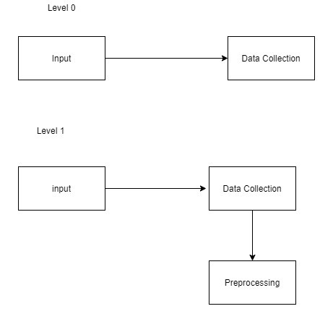
Data Flow Diagram:

Slide 9
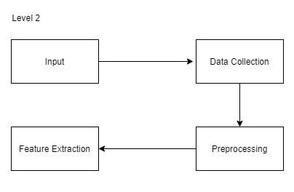
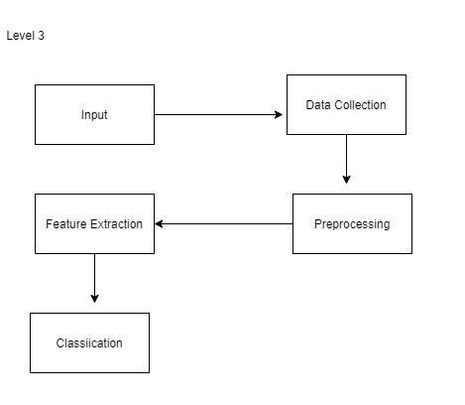

Slide 10
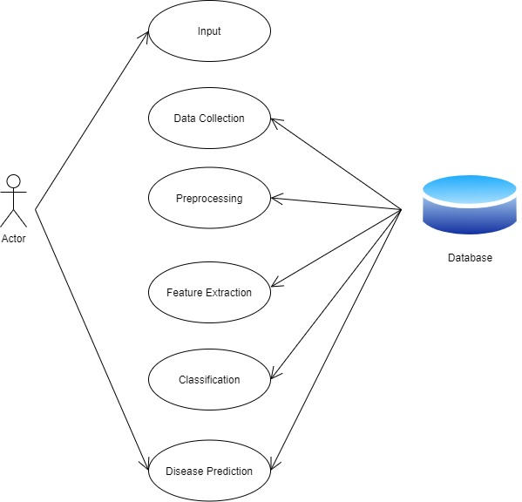
Use case Diagram:
System Design

Slide 11
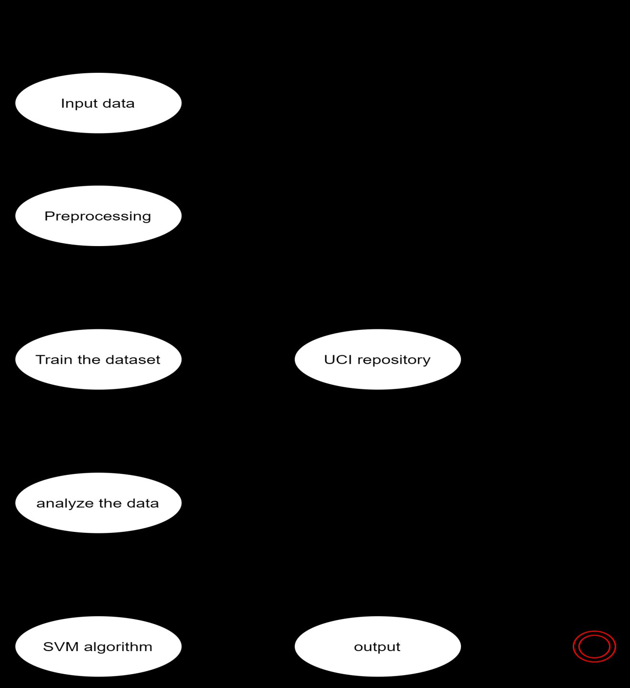
Activity Diagram

Slide 12
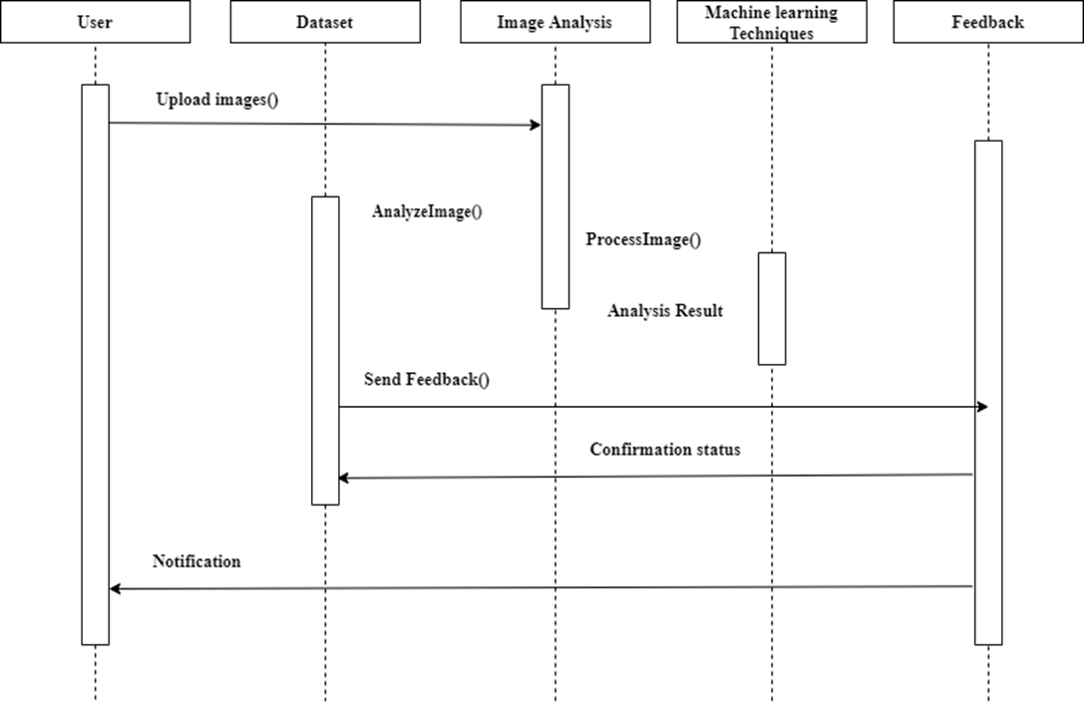
Sequence Diagram

Slide 13
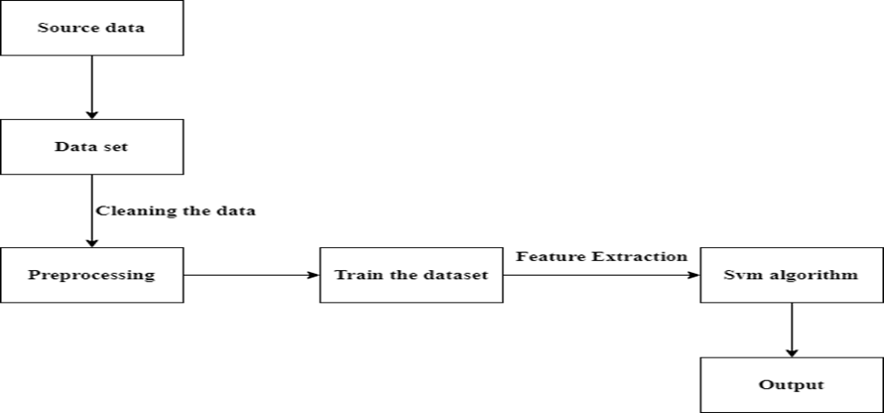
System Architecture
Bacterial leaf blight
Leaf smut
Brown spot

Slide 14
Data Collection
MODULES:
The data collection is done Kaggle.
The data collected has been check one by one before taking it as input data.
There are 2 classes named as affected plants and normal plants will be classified and each of the class contains images.
From the 80% of images used for training and 20% of images used for validation and testing.

Slide 15
Data Augmentation
1)Data augmentation is a method by which you can virtually increase the number of samples in your dataset using data you already have.
Here we have used Bacterial leaf blight , leaf smut, brown spot of rice leaf disease.
2)For image augmentation, it can be achieved by performing geometric transformations, changes to color, brightness, contrast or by adding some noise. In order to let our model, adapt to a different situation that might occur noisy data such as when raining season.

Slide 16
Plant classification
After training for each model, the final two models were generated. One model was trained directly based on original images, while the other one was created using image data produced by data augmentation.
Model history was used to record the training process. which displays the accuracy on the training set and testing set, it is described that the accuracy for the training set is having differences with 5% by with and without data augmentation.
Besides, the performance of the model without data augmentation having lower accuracy on the validation set, while the model with data augmentation has a higher result in the testing set.

Slide 17
TESTING TECNIQUES
White Box Testing:
This testing is also called as Glass box testing. In this testing, by knowing the specific functions that a product has been design to perform test can be conducted that demonstrate each function is fully operational at the same time searching for errors in each function. It is a test case design method that uses the control structure of the procedural design to derive test cases. Basis path testing is a white box testing.
Flow graph notation
Kilometric complexity
Deriving test cases
Graph matrices Control
BLACK BOX TESTING:
In this testing by knowing the internal operation of a product, test can be conducted to ensure that “all gears mesh”, that is the internal operation performs according to specification and all internal components have been adequately exercised. It fundamentally focuses on the functional requirements of the software.

Slide 18
SOFTWARE TESTING STRATEGIES
INTEGRATION TESTING: It is defined as a type of testing where software modules are integrated logically and tested as a group. A typical software project consists of multiple software modules, coded by different programmers. The purpose of this level of testing is to expose defects in the interaction between these software modules when they are integrated
PROGRAM TESTING:
Program testing is the process of executing a program with the intent of finding errors. A good test is one that has a high probability of finding an error. Program testing cannot show the absence of errors.
Security Testing :
It is a type of Software Testing that uncovers vulnerabilities of the system and determines that the data and resources of the system are protected from possible intruders. It ensures that the software system and application are free from any threats or risks that can cause a loss

Slide 19
PERFORMANCE TESTING:

Slide 21
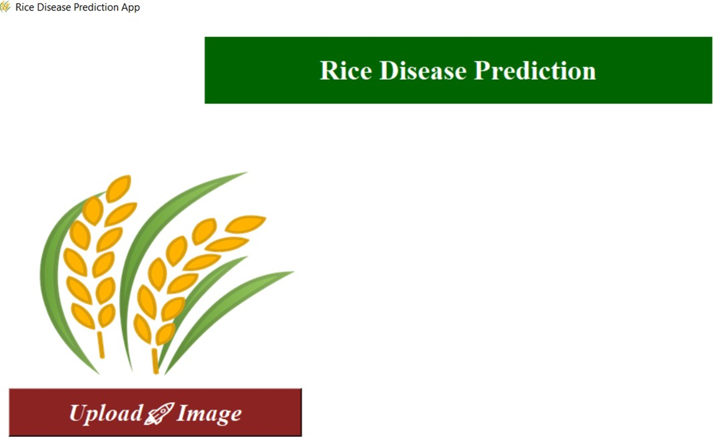
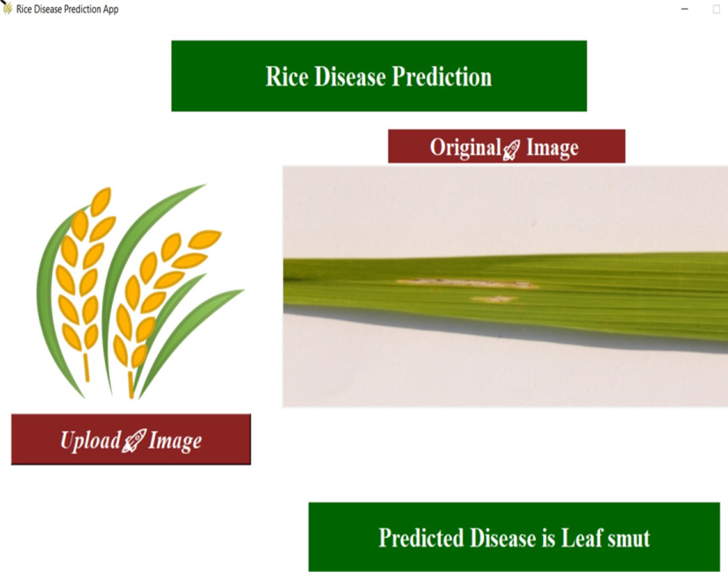
Screenshot:

Slide 22
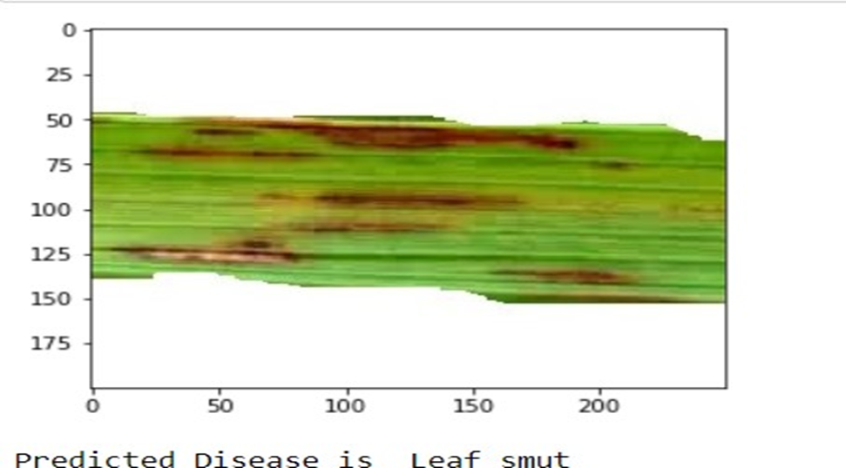

Slide 23
Conclusion
Rice plant diseases can make a big amount of loss in the agricultural domain. Due to climatic conditions and global warming issues the plants are deficient in terms of water content and necessary nutrients and easily get affected by diseases. Generally with the help of naked eye, farmers used to identify the disease, but they cannot identify what was the disease. In this project we developed a system to detect three rice plant diseases namely Bacterial Leaf Blight, Brown Spot, Leaf Blight.
We have collected dataset of leaf images from UCI repository. We had used Machine learning techniques to identify the diseases accordingly. So, it helps farmers to improve the quality of farming and increase the crop production.

Slide 24
Publications:
Title of the paper: Pesticide Suggestions and Crop Disease Classification Using Machine Learning
Journal name: International Journal of Engineering Science and Computing(IJESC)
Volume:11,issue no:04,April 2021.
e-ISSN:2250-1371.

Slide 25
References
[1] K. Padmavathi, and K. Thangadurai, “Implementation of RGB and Gray scale images in plant leaves disease detection –comparative study,” Indian J. of Sci. and Tech., vol. 9, pp. 1- 6,Feb. 2016. [2] Dr.K.Thangadurai, K.Padmavathi, “Computer Vision image Enhancement For Plant Leaves Disease Detection”, 2014 World Congress on Computing and Communication Technologies.
[3] Kiran R. Gavhale, and U. Gawande, “An Overview of the Research on Plant Leaves International Journal of Pure and Applied Mathematics Special Issue 882 Disease detection using Image Processing Techniques
[4] Y. Q. Xia, Y. Li, and C. Li, “Intelligent Diagnose System of Wheat Diseases Based on Android Phone,” J. of Infor. & Compu. Sci., vol. 12, pp. 6845-6852, Dec. 2015.
[5] Wenjiang Huang, Qingsong Guan, JuhuaLuo, Jingcheng Zhang, Jinling Zhao, Dong Liang, Linsheng Huang, and Dongyan Zhang, “New Optimized Spectral Indices for Identifying and Monitoring Winter Wheat Diseases”, IEEE journal of selected topics in applied earth observation and remote sensing,Vol. 7, No. 6, June 2014

Slide 26
[6] Monica Jhuria, Ashwani Kumar, and RushikeshBorse, “Image Processing For Smart Farming: Detection Of Disease And Fruit Grading”, Proceedings of the 2013 IEEE Second International Conference on Image Information Processing (ICIIP-2013)
[7] Zulkifli Bin Husin, Abdul Hallis Bin Abdul Aziz, Ali Yeon Bin MdShakaffRohaniBinti S Mohamed Farook, “Feasibility Study on Plant Chili Disease Detection Using Image Processing Techniques”, 2012 Third International Conference on Intelligent Systems Modelling and Simulation.
[8] Mrunalini R. Badnakhe, Prashant R. Deshmukh, “Infected Leaf Analysis and Comparison by Otsu Threshold and k-Means Clustering”, International Journal of Advanced Research in Computer Science and Software Engineering, Volume 2, Issue 3, March 2012.
[9] H. Al-Hiary , S. Bani-Ahmad, M. Reyalat, M. Braik and Z. ALRahamneh, “Fast and Accurate Detection and Classification of Plant Diseases”, International Journal of Computer Applications (0975 – 8887)Volume 17– No.1, March 2011

